Slide 1
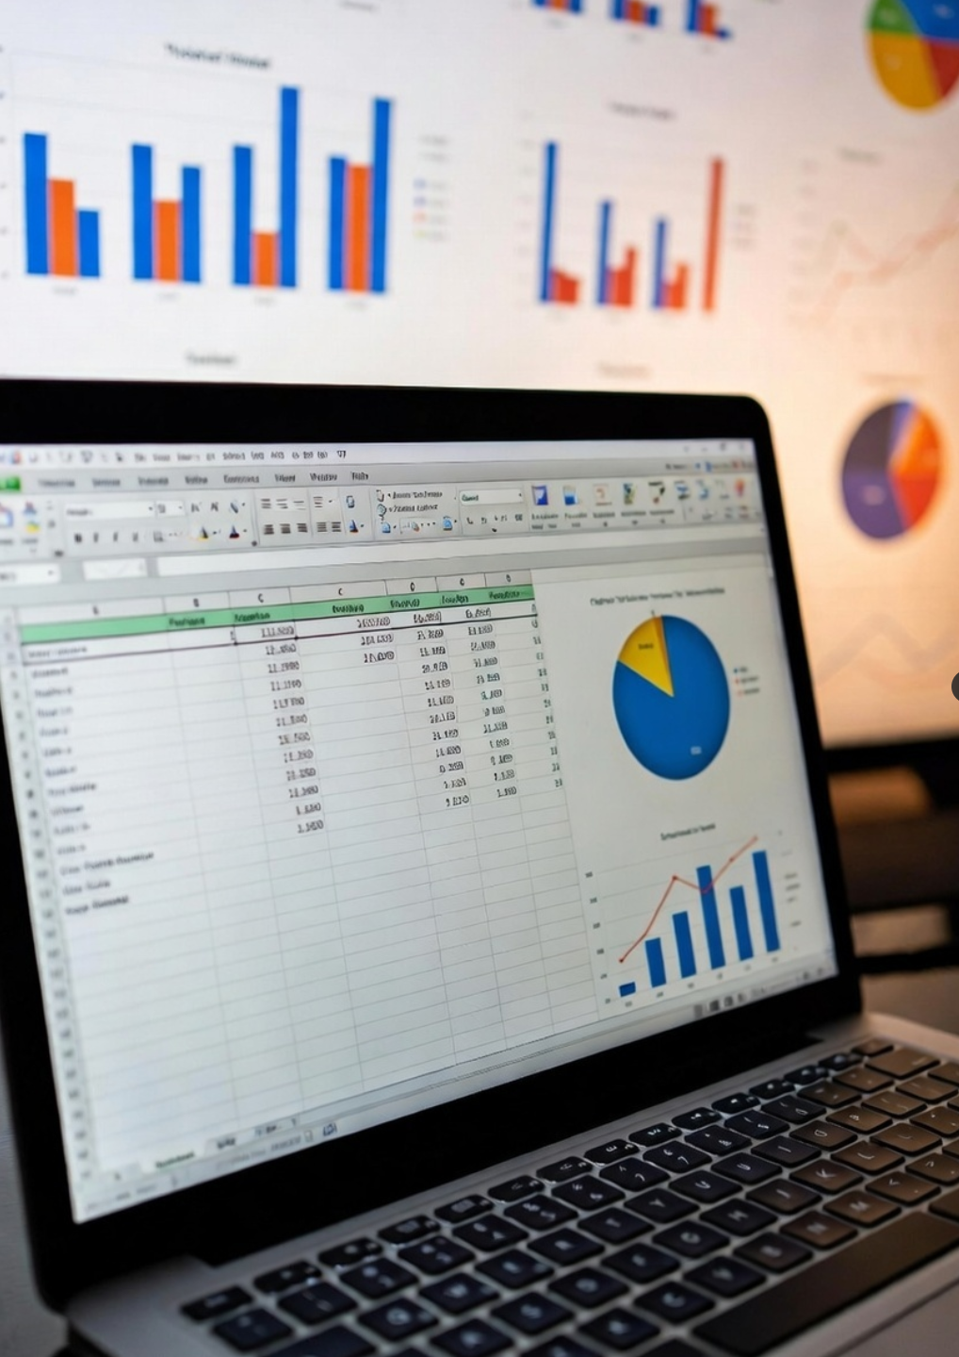
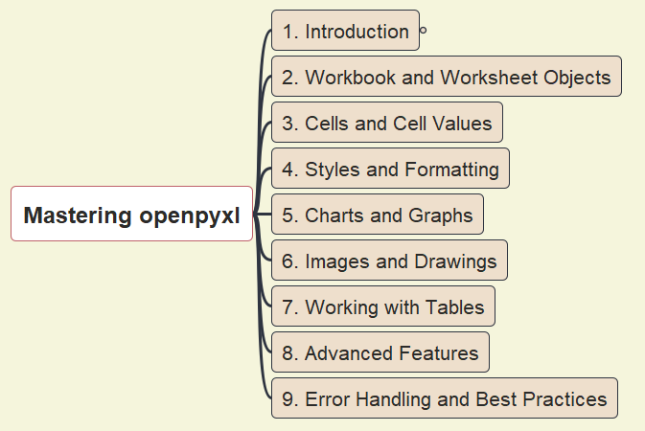
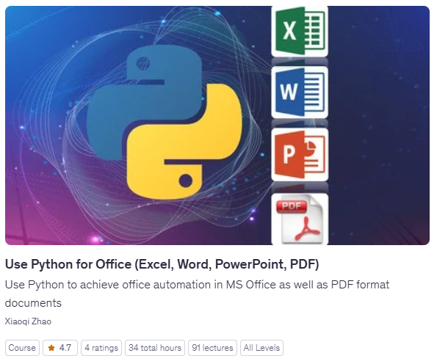
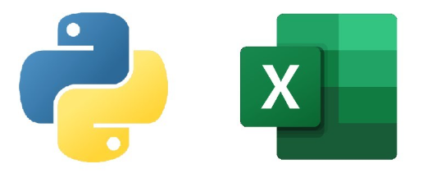
Mastering Python’s openpyxl - Opening & Introduction
001
openpyxl
python-docx
python-pptx
pypdf2/3

Slide 2
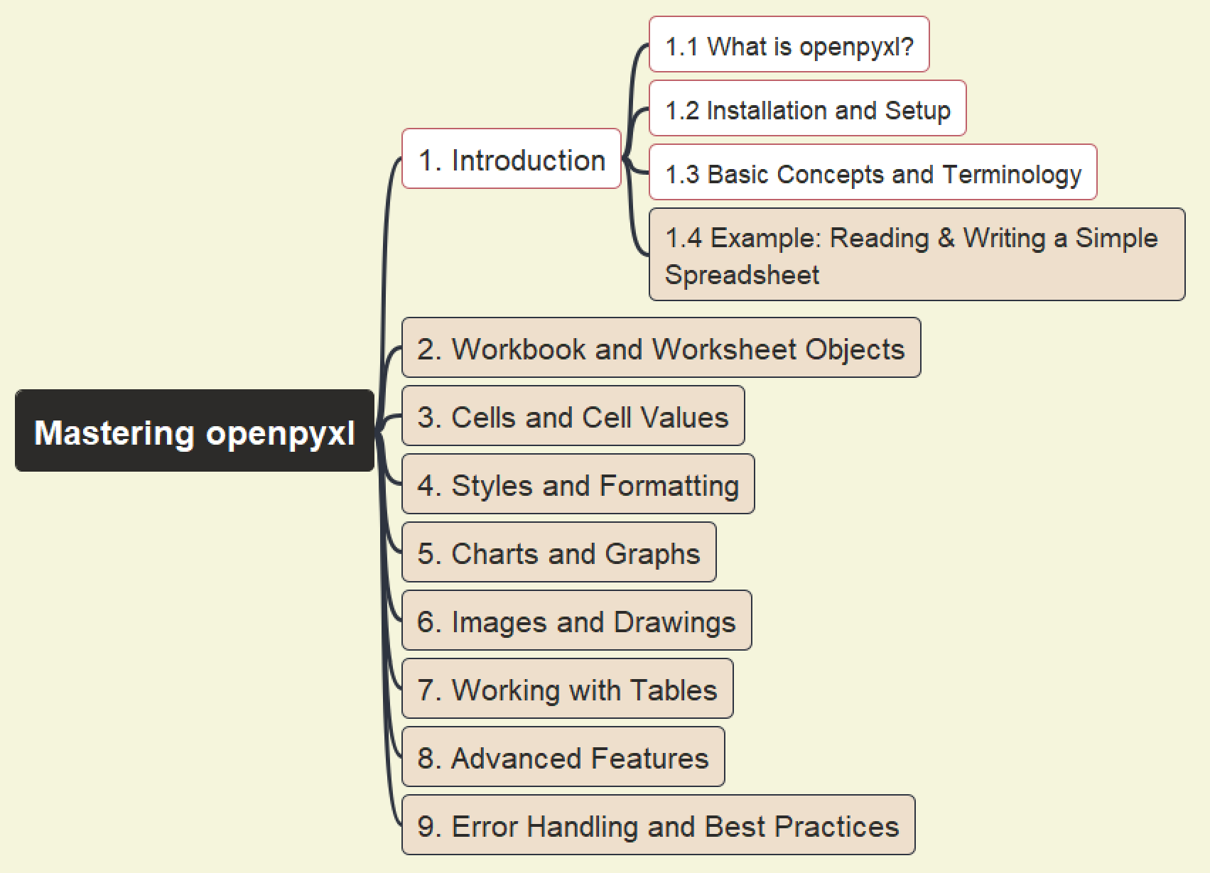
Mastering openpyxl
002
1. Introduction – About openpyxl

Slide 3
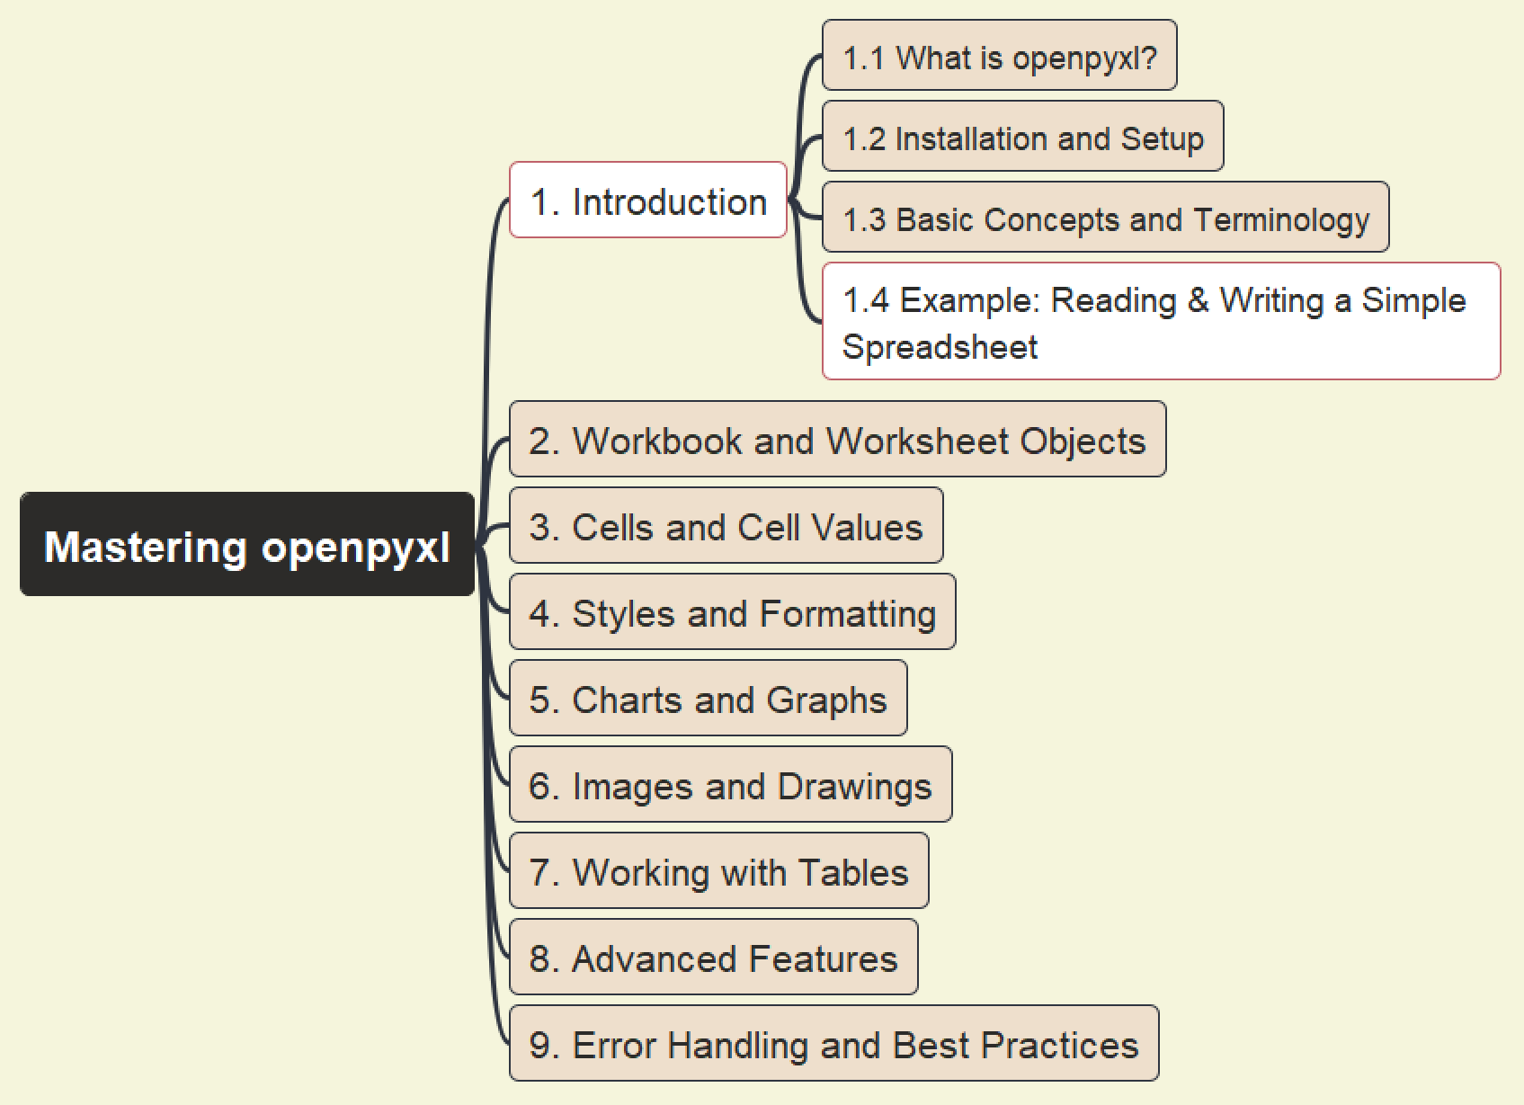
Mastering openpyxl
003
1. Introduction – First Sample

Slide 4
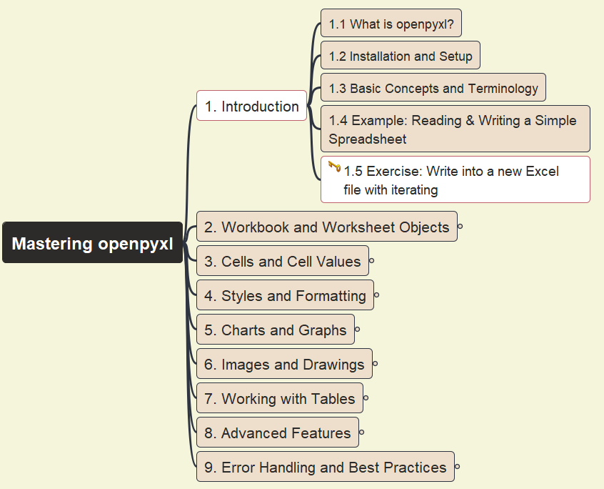
Mastering openpyxl
004
Question:
Write into a new Excel file with iterating
1. Introduction – First Exercise

Slide 5
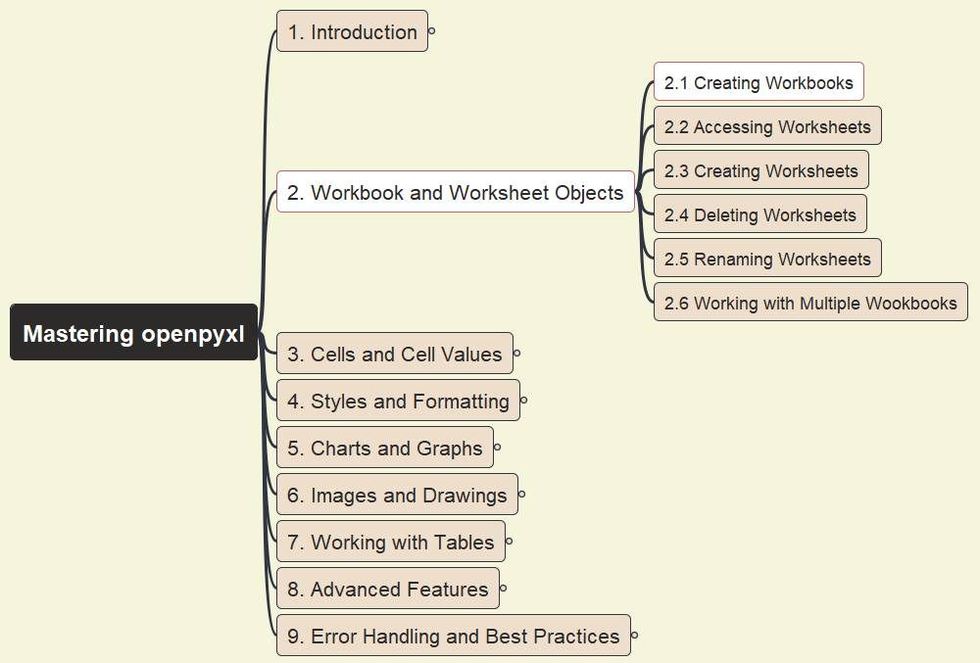
Mastering openpyxl
005
2. Workbook and Worksheet Objects
2.1 Creating Workbooks

Slide 6
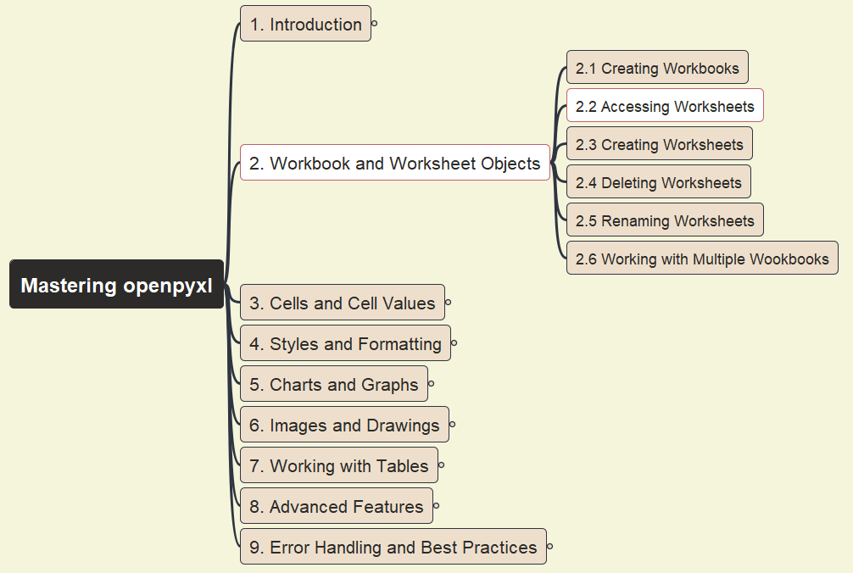
Mastering openpyxl
006
2. Workbook and Worksheet Objects
2.2 Accessing Worksheets

Slide 7
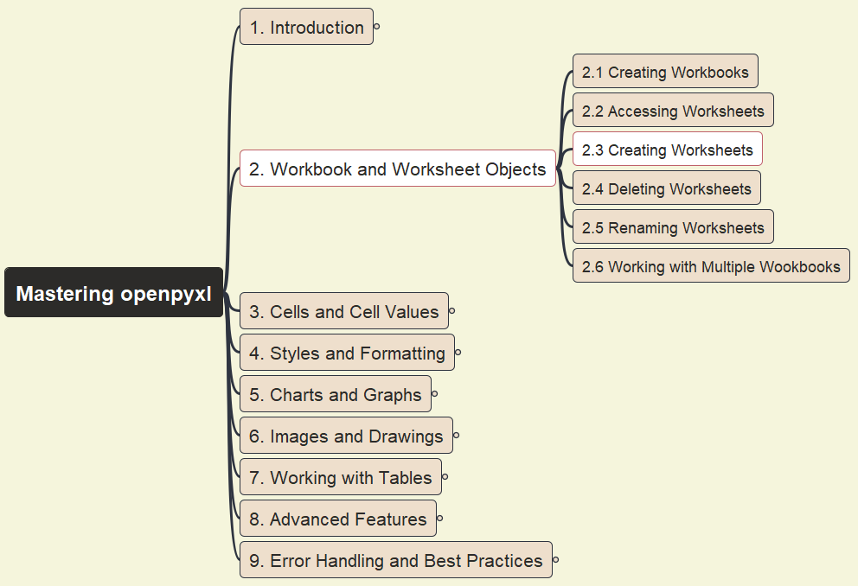
Mastering openpyxl
007
2. Workbook and Worksheet Objects
2.3 Creating Worksheets

Slide 8
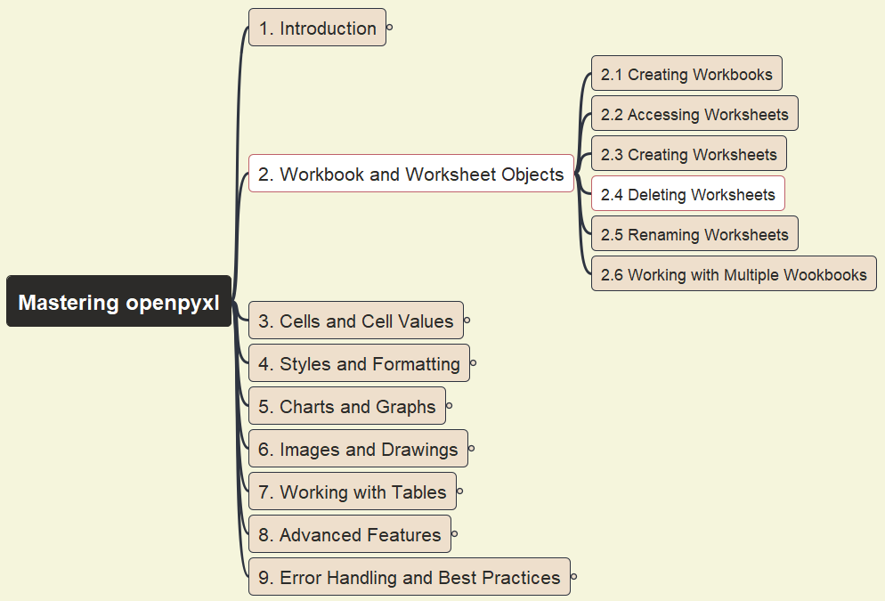
Mastering openpyxl
008
New Repository:
https://github.com/yasenstar/learn_openpyxl
2. Workbook and Worksheet Objects
2.4 Deleting Worksheets

Slide 9
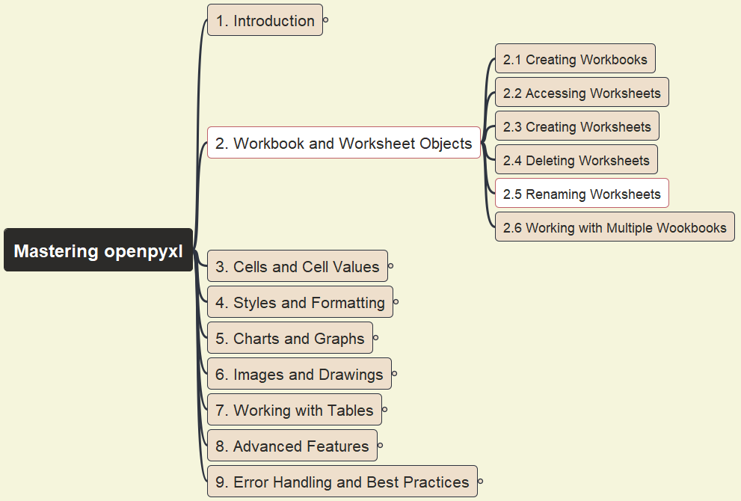
Mastering openpyxl
009
2. Workbook and Worksheet Objects
2.5 Renaming Worksheets

Slide 10
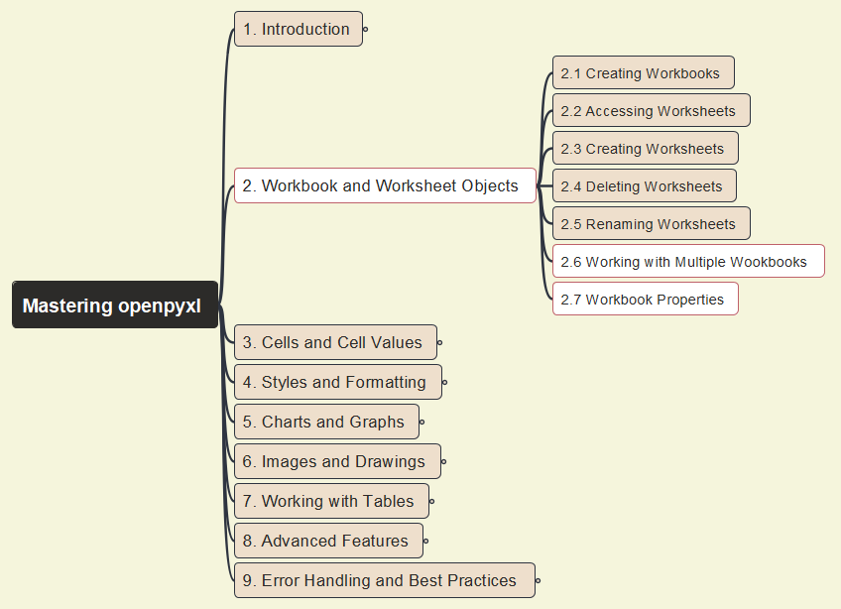
Mastering openpyxl
010
2. Workbook and Worksheet Objects
2.6 Working w/ Multiple Workbooks & 2.7 Workbook Properties

Slide 11
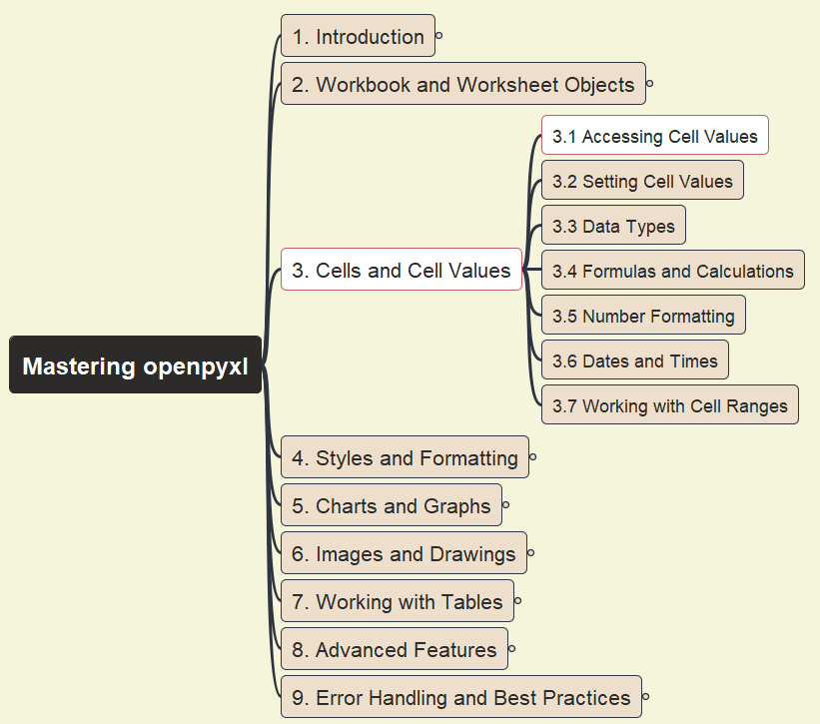
Mastering openpyxl
011
3. Cells and Cells Values
3.1 Accessing Cell Values

Slide 12
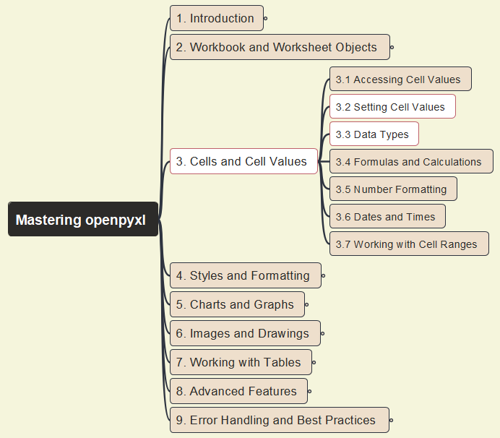
Mastering openpyxl
012
3. Cells and Cells Values
3.2 Setting Cell Values & 3.3 Data Types

Slide 13
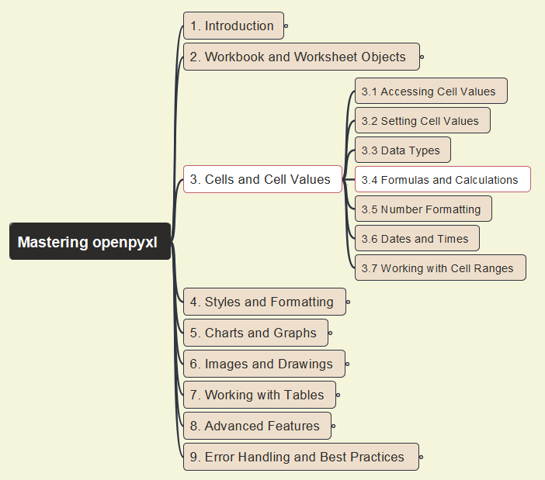
Mastering openpyxl
013
3. Cells and Cells Values
3.4 Formulas and Calculations

Slide 14
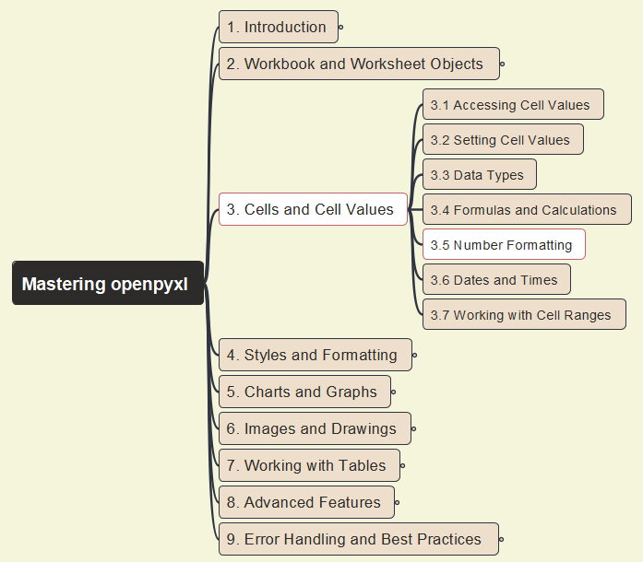
Mastering openpyxl
014
3. Cells and Cells Values
3.5 Number Formatting

Slide 15
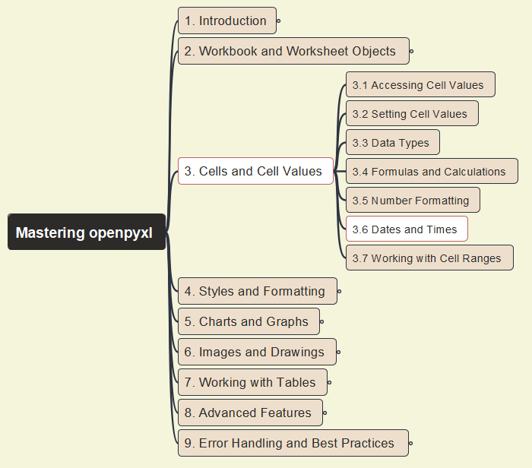
Mastering openpyxl
015
3. Cells and Cells Values
3.6 Dates and Times

Slide 16
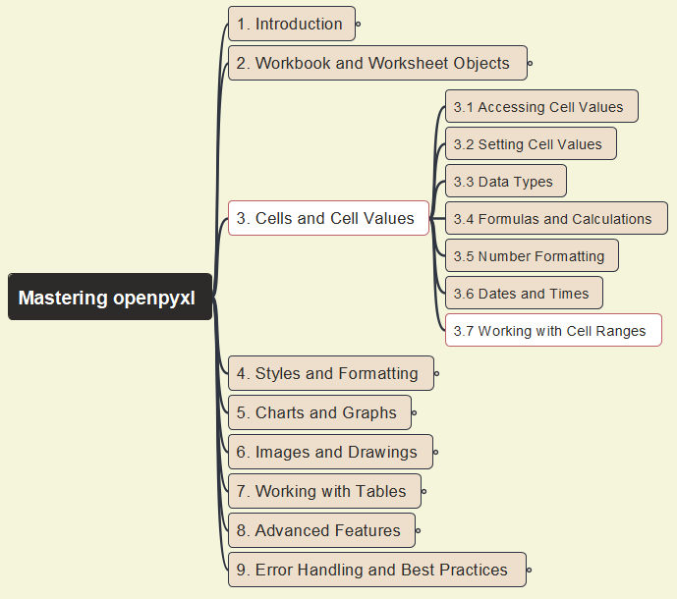
Mastering openpyxl
016
3. Cells and Cells Values
3.7 Working with Cell Ranges

Slide 17
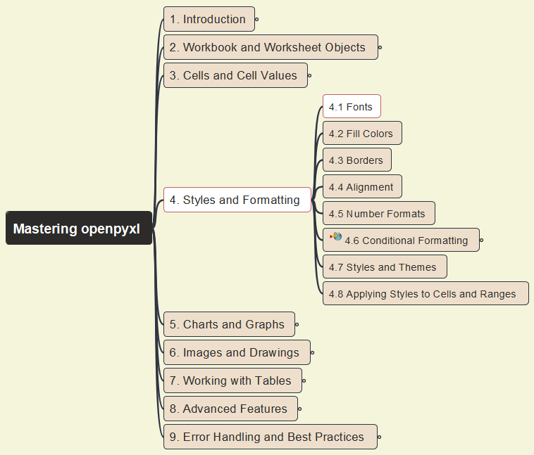

Mastering openpyxl
017
4. Styles and Formatting
4.1 Fonts

Slide 18
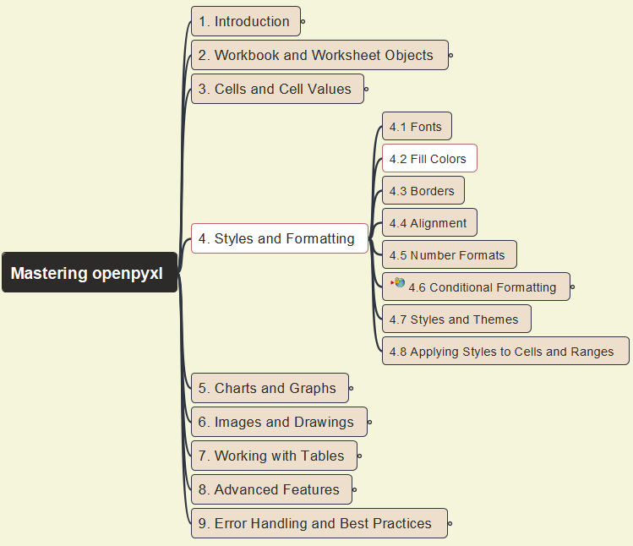

Mastering openpyxl
018
4. Styles and Formatting
4.2 Fill Colors

Slide 19
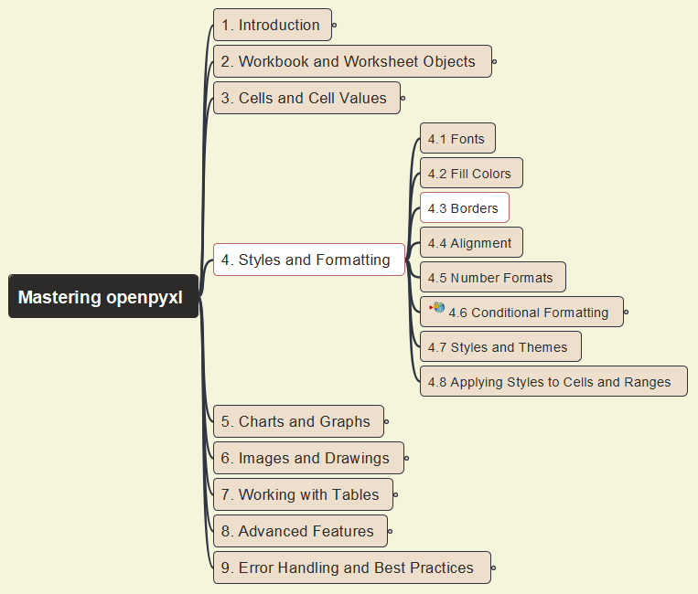

Mastering openpyxl
019
4. Styles and Formatting
4.3 Borders

Slide 20
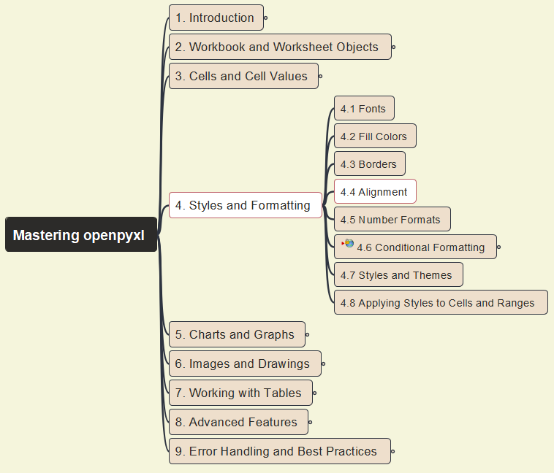
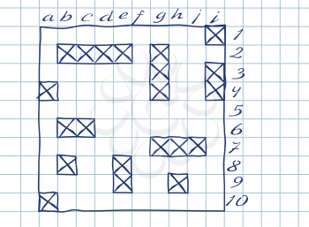
Mastering openpyxl
020
4. Styles and Formatting
4.4 Alignment

Slide 21
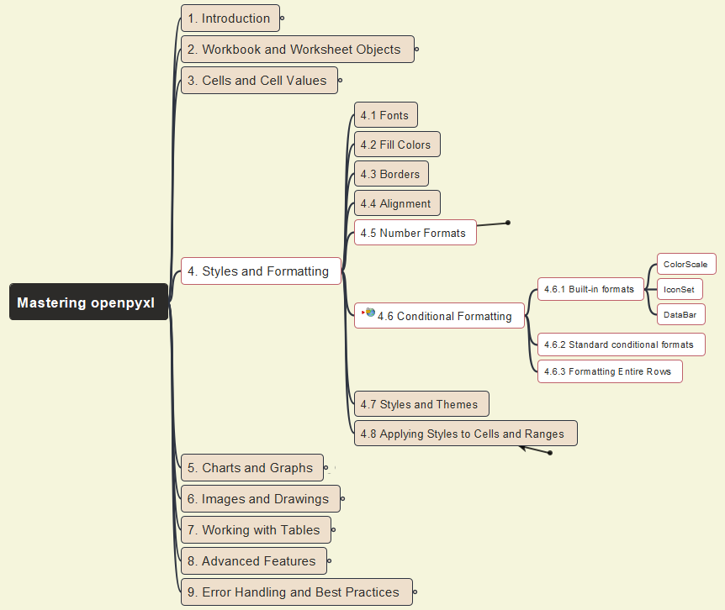

Mastering openpyxl
021
4. Styles and Formatting
4.5 Number Formats &
4.6 Conditional Formatting

Slide 22
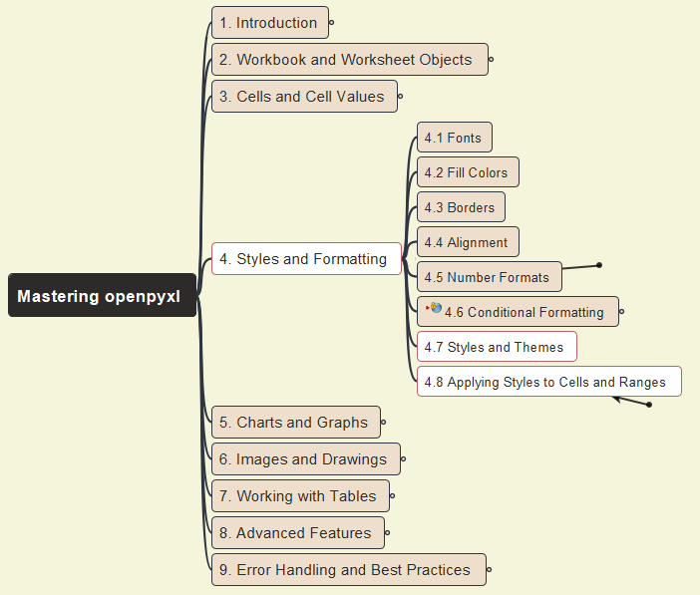
Mastering openpyxl
022
4. Styles and Formatting
4.7 Styles and Themes &
4.8 Applying Styles to Cells and Ranges

Slide 23
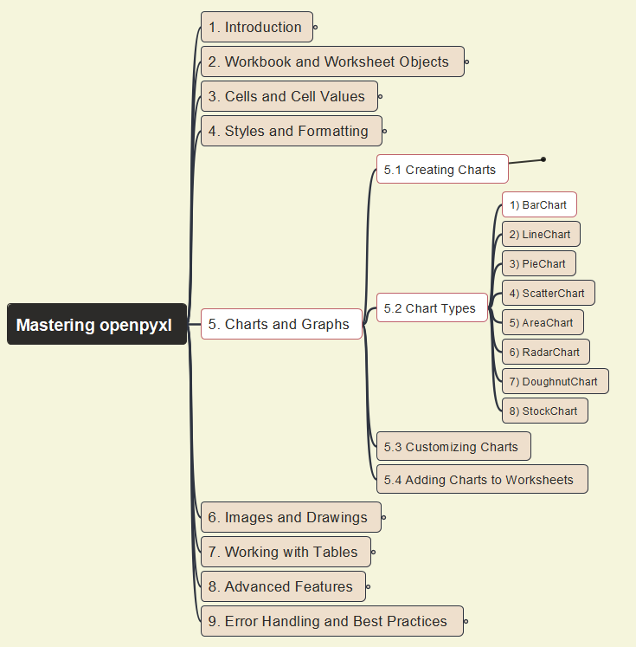
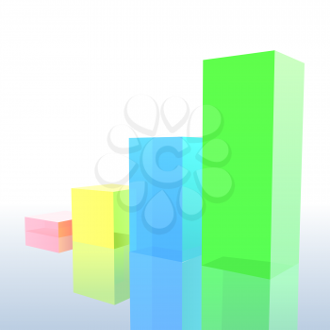
Mastering openpyxl
023
5. Charts and Graphs
5.1 Creating Charts – 1) BarChart

Slide 24

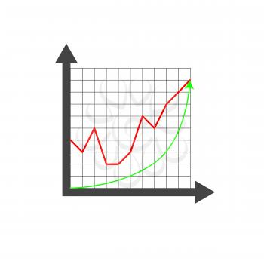
Mastering openpyxl
024
5. Charts and Graphs
5.2 Creating Charts – 2) LineChart

Slide 25
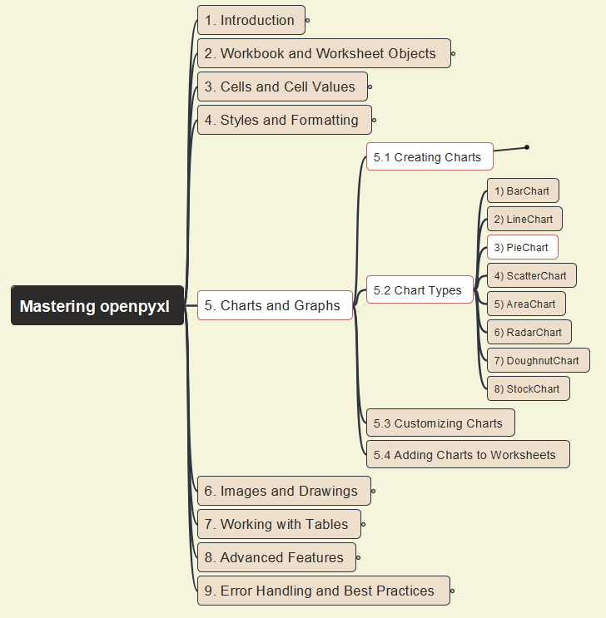
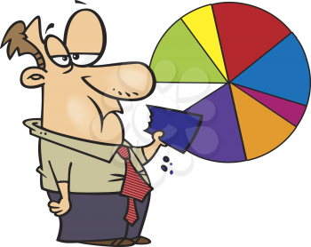
Mastering openpyxl
025
5. Charts and Graphs
5.2 Creating Charts – 3) PieChart

Slide 26
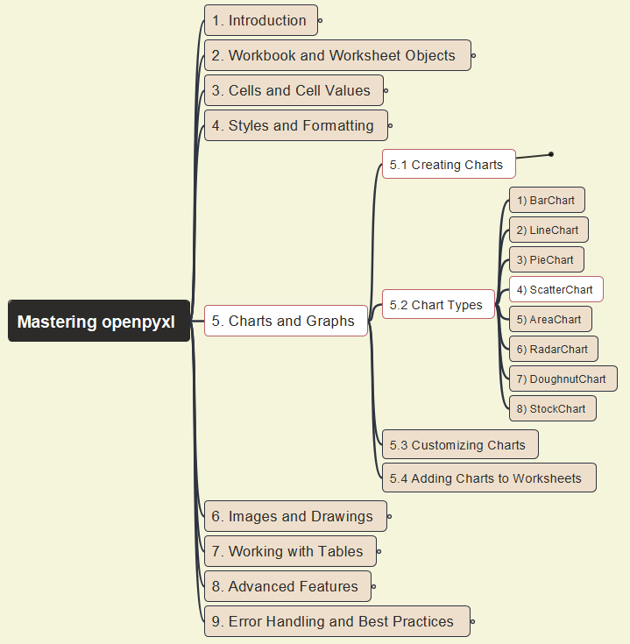

Mastering openpyxl
026
5. Charts and Graphs
5.2 Creating Charts – 4) ScatterChart

Slide 27
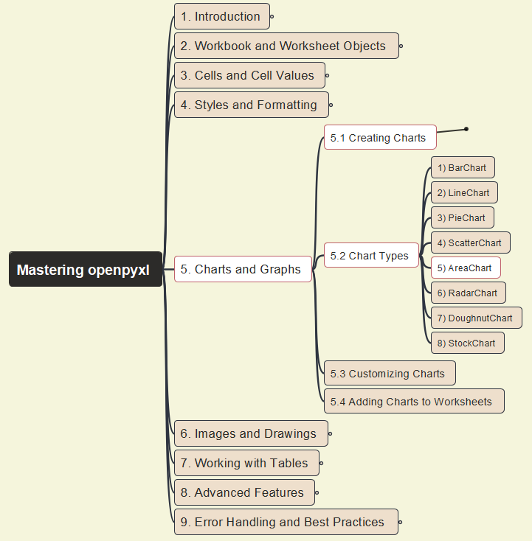
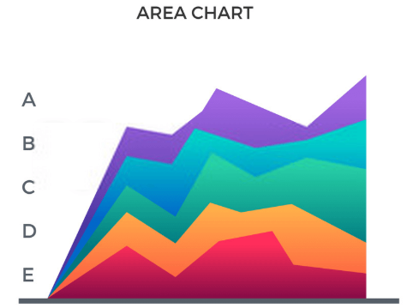
Mastering openpyxl
027
5. Charts and Graphs
5.2 Creating Charts – 5) AreaChart

Slide 28
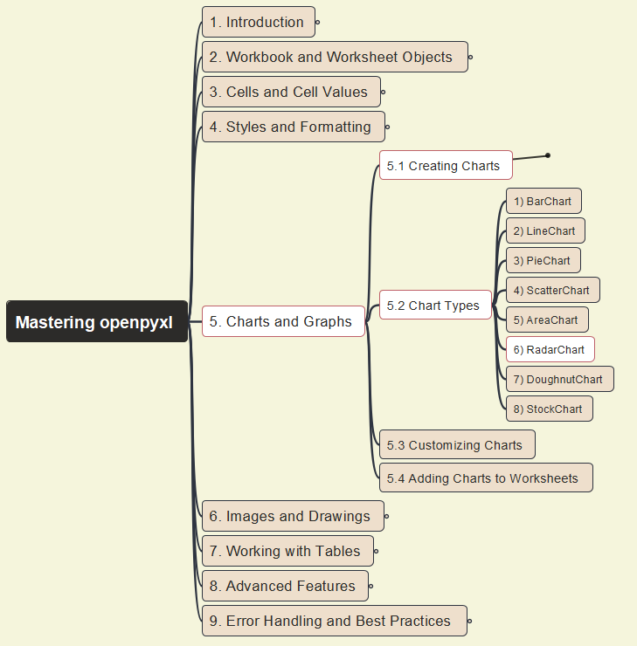

Mastering openpyxl
028
5. Charts and Graphs
5.2 Creating Charts – 6) RadarChart

Slide 29
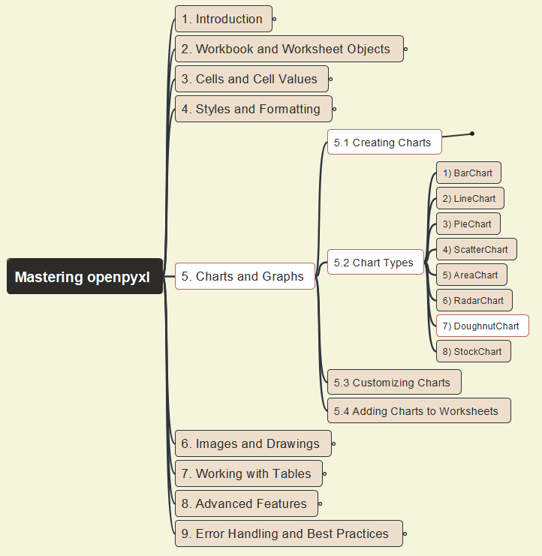
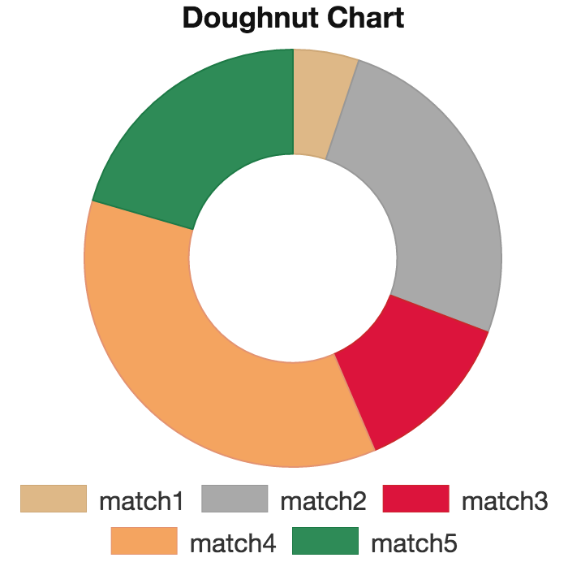
Mastering openpyxl
029
5. Charts and Graphs
5.2 Creating Charts – 7) DoughnutChart

Slide 30
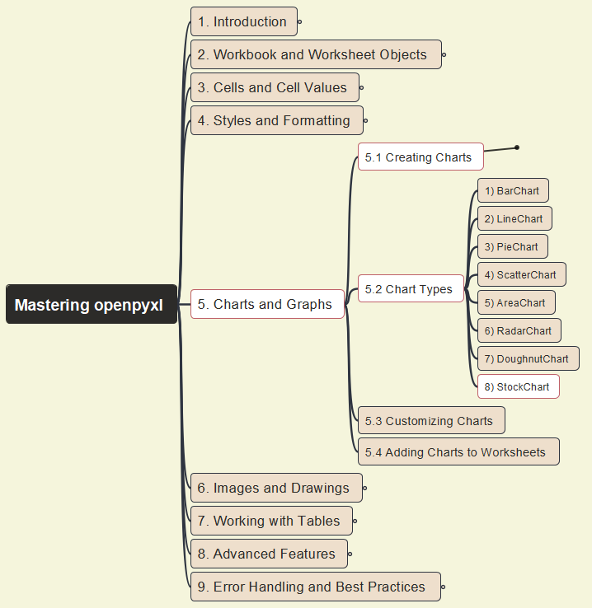
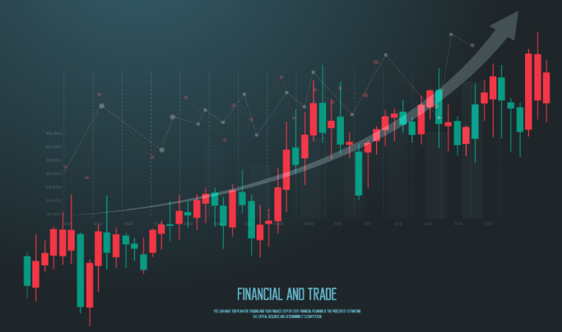
Mastering openpyxl
030
5. Charts and Graphs
5.2 Creating Charts – 8) StockChart

Slide 31
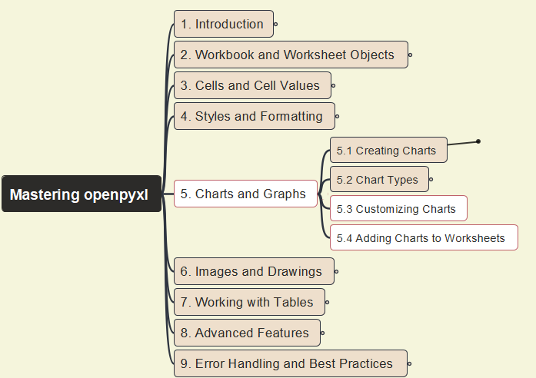
Mastering openpyxl
031
5. Charts and Graphs
5.3 Customizing Charts & 5.4 Add Charts to Worksheets

Slide 32
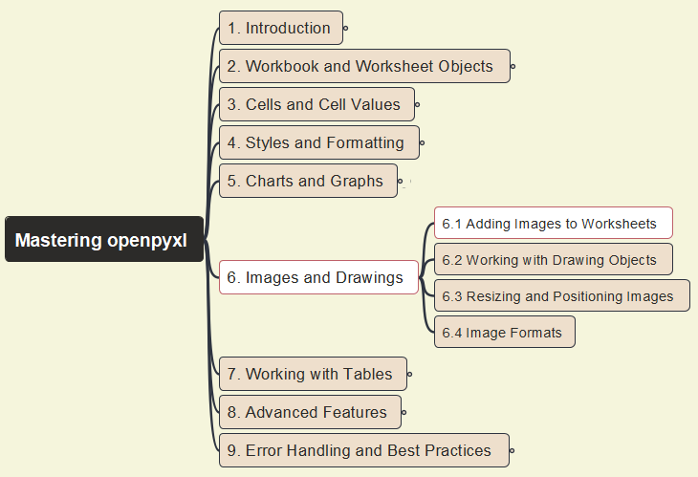
Mastering openpyxl
032
6. Images and Drawings
6.1 Adding Images to Worksheets

Slide 33
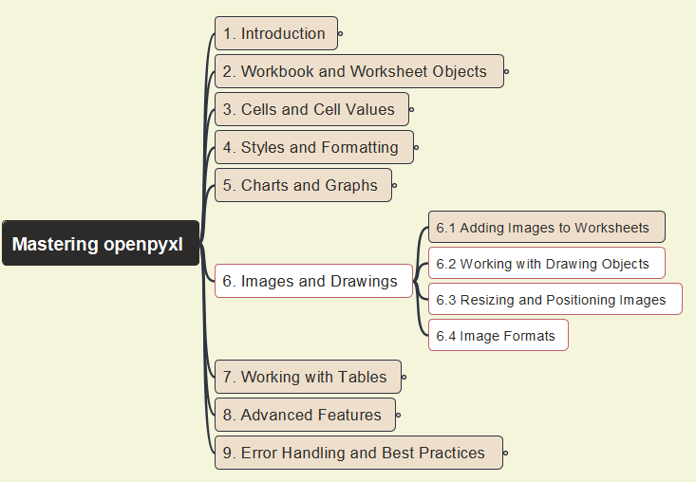
Mastering openpyxl
033
6. Images and Drawings
6.2 Working with Drawing Object
6.3 Resizing and Positioning Images
6.4 Image Formats

Slide 34
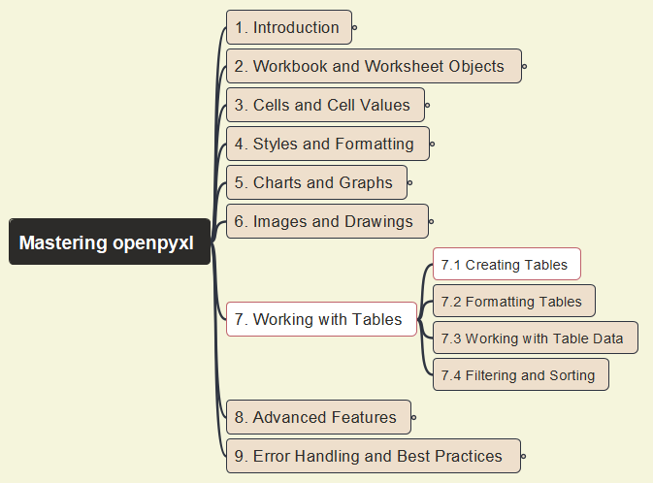
Mastering openpyxl
034
7. Working with Tables
7.1 Creating Tables

Slide 35
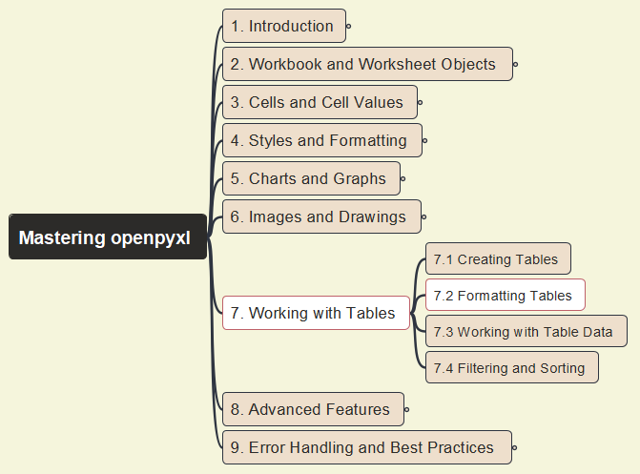
Mastering openpyxl
035
7. Working with Tables
7.2 Formatting Tables

Slide 36
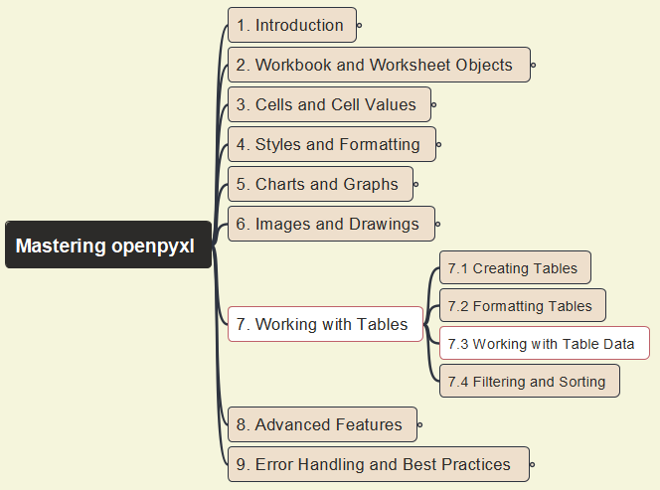
Mastering openpyxl
036
7. Working with Tables
7.3 Working with Table Data

Slide 37
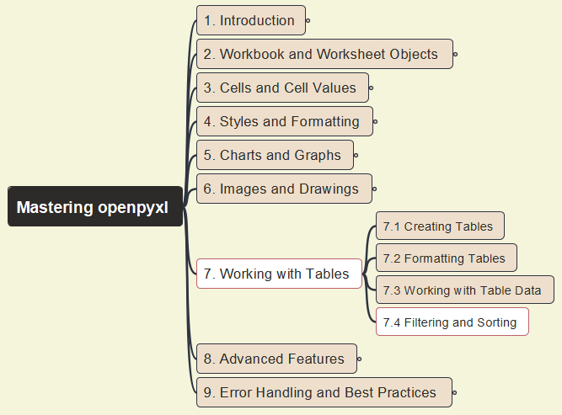
Mastering openpyxl
037
7. Working with Tables
7.4 Filtering and Sorting

Slide 38
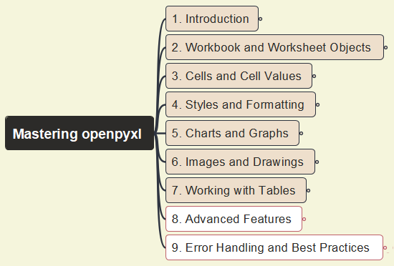

Mastering openpyxl
038
Closing and Summary

Slide 39


